Slide 1
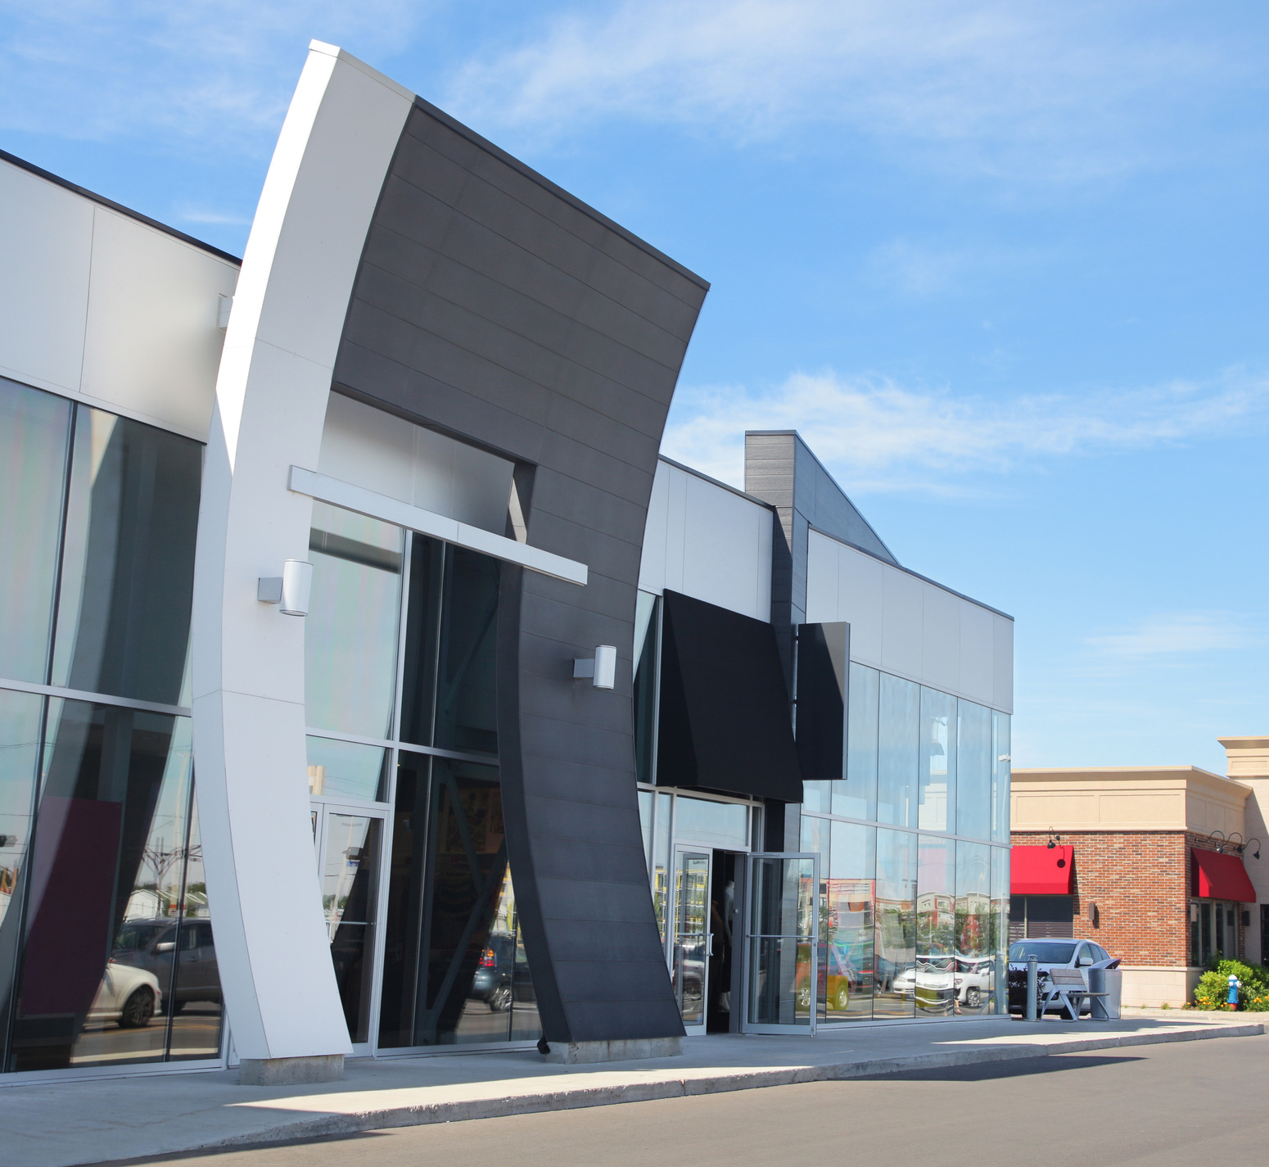
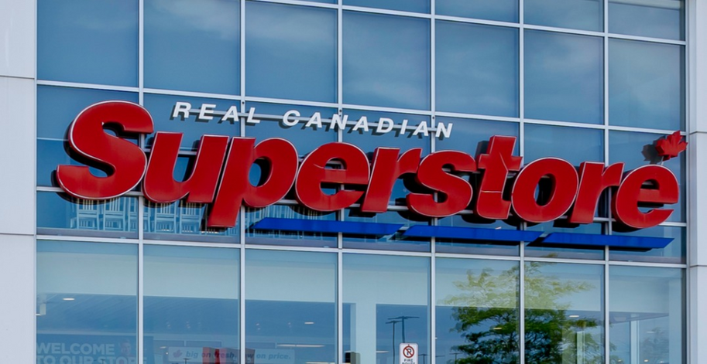
01
Business Intelligence Project
English (US) / Japanese / Korean / Dutch / Español
Envisioning a brighter future

Slide 2

Table of Contents
MAIN POINTS:
01
About the company
02
Project Objective
03
Sales & Profit
04
Data info
05
Data relations
English (US) / Japanese / Korean / Dutch / Español
Envisioning a brighter future

Slide 3
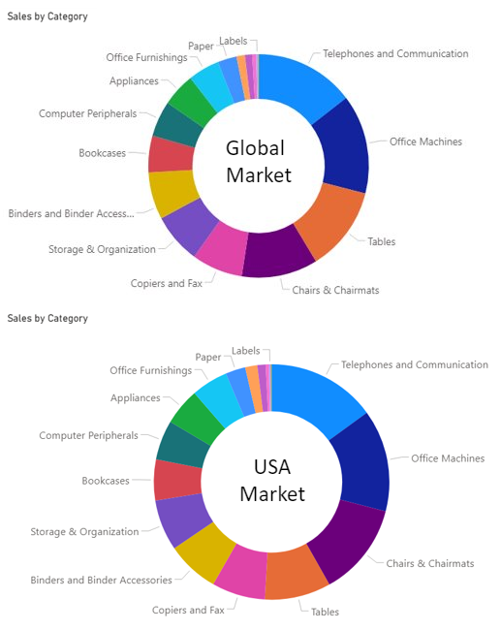
ABOUT OUR BUSINESS
SuperStore is a multi-million dollar transnational retailer with operations in several branches of business​
By far, its most profitable and desirable market is the USA​
Is a recognized player, dedicated to quality in every area of business and has an everlasting desire to tap into different and promising markets​
Super Store is looking expand their market footprint in the USA​
English (US) / Japanese / Korean / Dutch / Español
Envisioning a brighter future

Slide 4
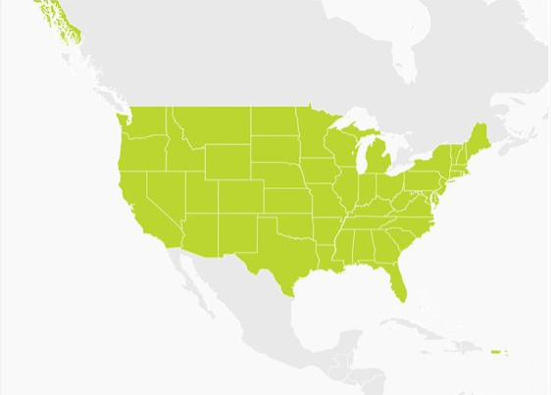
Project Objective
EXPAND OUR BUSINESS
ON THE USA MARKET​
English (US) / Japanese / Korean / Dutch / Español
Envisioning a brighter future

Slide 5

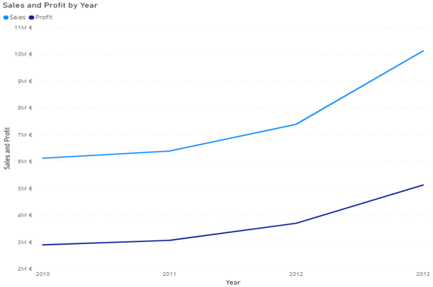
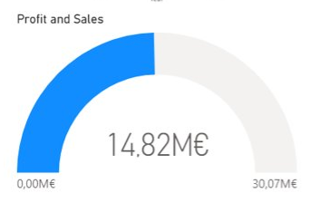
05
Business Intelligence Project
SALES & PROFIT - WORLDWIDE
14,82M
30,07M
Profit
Sales

Slide 6
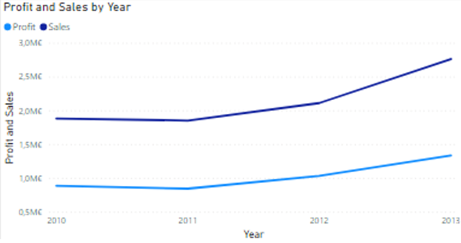
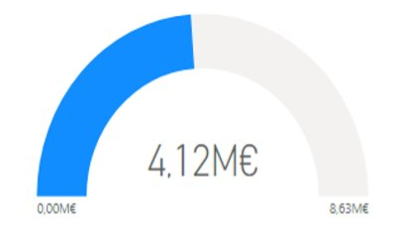
05
Business Intelligence Project
SALES & PROFIT - USA
4,12M
8,63M
Profit $
Sales $

Slide 7
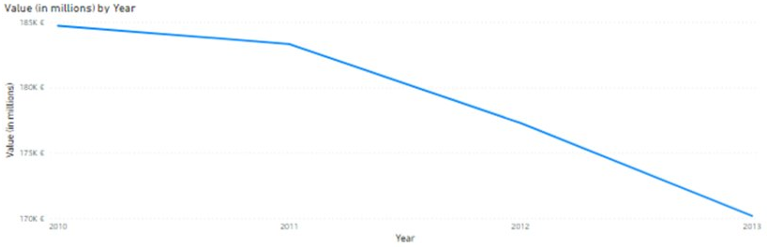
05
Business Intelligence Project
RETAIL SECTOR - TOTAL VOLUME
2010 - 2013
715,62B
Sector Volume

Slide 8
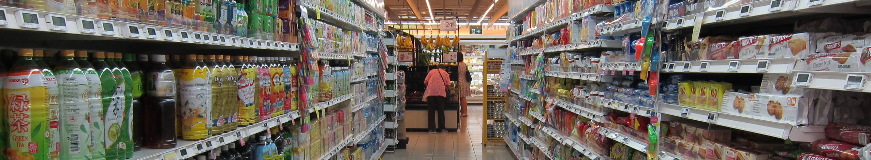
The Data Scoop
SuperStores’s Business Data: Sales, Customers, Products, Orders and Locations​
Market Cap: shows the monthly value (in millions) of the USA market
2 Different Datasets
1 January 2010
31 December 2013
11297 orders
English (US) / Japanese / Korean / Dutch / Español
Envisioning a brighter future

Slide 9
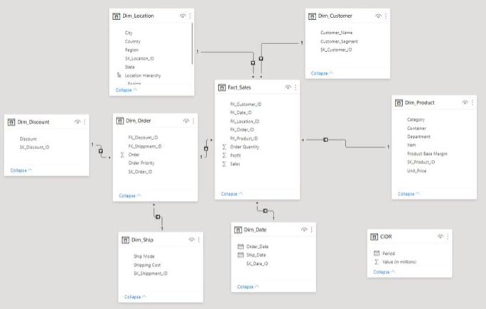
How our data relates
Snowflake Schema
5 Dimensions
4 Hierarchies
1 Fact Table
English (US) / Japanese / Korean / Dutch / Español
Envisioning a brighter future

Slide 10
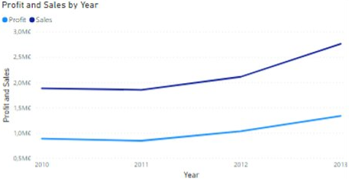
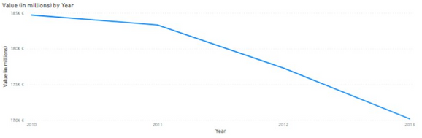
Increased our USA Sales Volume and Profit
REMARKS
On these 4 years
Decreased Volume of USA Retail Sector
English (US) / Japanese / Korean / Dutch / Español
Envisioning a brighter future

Slide 11
15
Business Intelligence Project
Gabriel Cardoso m20201027​
João Lucas m20200758​
Contact Us
João Chaves m20200627​
WE'D LOVE TO HEAR FROM YOU.
Luís Almeida m20200666​
English (US) / Japanese / Korean / Dutch / Español
Envisioning a brighter future

